Slide 1
Autonomous Vehicle: A Brief Introduction
Presented by
Anisha Sen
Junior Research Fellow
Indian Institute of Astrophysics, Bangalore

Slide 2
WHAT IS AN AUTONOMOUS VEHICLE?
An autonomous vehicle, or a driverless vehicle, is one that is able to operate itself and perform necessary functions without any human intervention, through ability to sense its surroundings.
An autonomous vehicle utilizes a fully automated driving system in order to allow the vehicle to respond to external conditions that a human driver would manage.

Slide 3
What are the Advantages?
Autonomous vehicle technology may be able to provide certain advantages compared to human-driven vehicles. One such potential advantage is that they could provide increased safety on the road – vehicle crashes cause many deaths every year, and automated vehicles could potentially decrease the number of casualties as the software used in them is likely to make fewer errors in comparison to humans. A decrease in the number of accidents could also reduce traffic congestion, which is a further potential advantage posed by autonomous vehicles. Autonomous driving can also achieve this by the removal of human behaviors that cause blockages on the road, specifically stop-and-go traffic.
Another possible advantage of automated driving is that people who are not able to drive – due to factors like age and disabilities – could be able to use automated cars as more convenient transport systems.
Additional advantages that come with an autonomous car are elimination of driving fatigue and being able to sleep during overnight journeys.

Slide 4
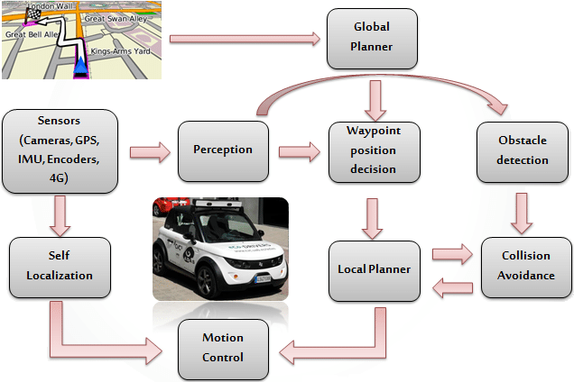
How an Autonomous Vehicle works?

Slide 5
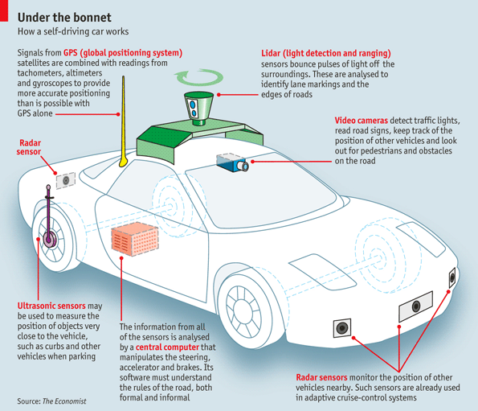
Basic Physical Ecosystem of an Autonomous Vehicle
•Global Positioning System (GPS)
•Light Detection and Ranging (LIDAR)
•Cameras (Video)
•Ultrasonic Sensors
•Central Computer
•Radar Sensors
•Dedicated Short-Range Communications-Based Receiver (not pictured)
Source: The Economist, “How does a self-driving car work?”

Slide 6
Key Physical Components of Autonomous Vehicles
(Hardwires)
• Cameras – Provide real-time obstacle detection to facilitate lane departure and track roadway information (like road signs).
• Radar(Radio Detection and Ranging) – Radio waves detect short & long-range depth.
• LIDAR – Measures distance by illuminating target with pulsed laser light and measuring reflected pulses with sensors to create 3-D map of area.
• GPS – Triangulates position of car using satellites. Current GPS technology is limited to a certain distance. Advanced GPS is in development.
• Ultrasonic Sensors – Uses high-frequency sound waves and bounce-back to calculate distance. Best in close range.
• Central Computer – “Brain” of the vehicle. Receives information from various components and helps direct vehicle overall.
• DRSC - Based Receiver – Communications device permitting vehicle to communicate with other vehicles (V2V) using DSRC, a wireless communication standard that enables reliable data transmission in active safety applications. NHTSA has promoted the use of DSRC.

Slide 7
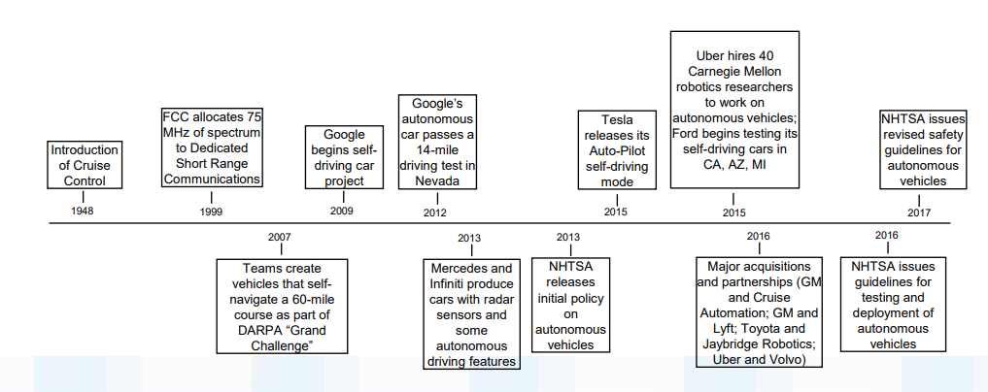
History of Autonomous vehicle

Slide 8
Recent Achievements
January 2018 – Toyota announces “e-Palette” concept vehicle which is a fully electric autonomous vehicle that can be customized by a partner for applications such as food deliveries (Pizza Hut), ride-sharing (Uber), or store fronts (Amazon).
•January 2018 – Udelv, a Bay Area tech company, completed the first delivery of goods by a self-driving car when it delivered groceries in San Mateo.
•February 2018 – Hyundai announced that a fleet of its fuel cell electric cars made a successful fully automated trip from Seoul to Pyeongchang. This is the first time a Level 4 car has been operated with fuel cell electric cars.

Slide 9
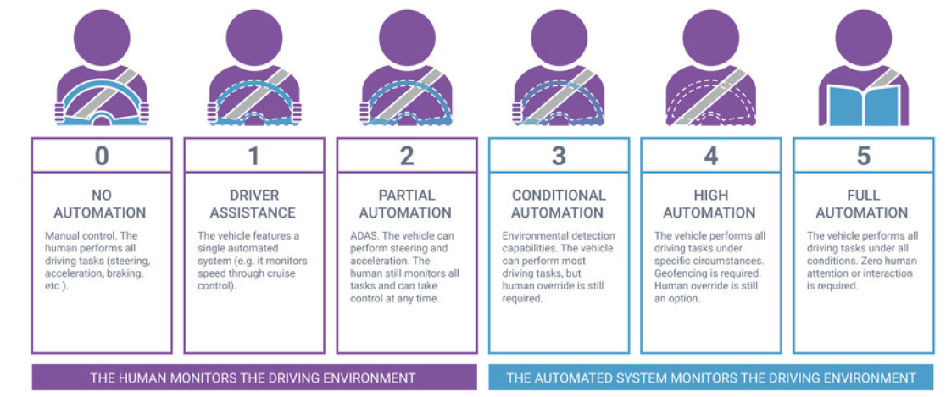
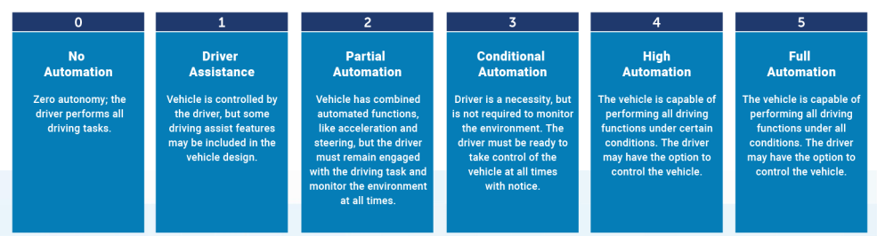
Levels of Driving Automation

Slide 10
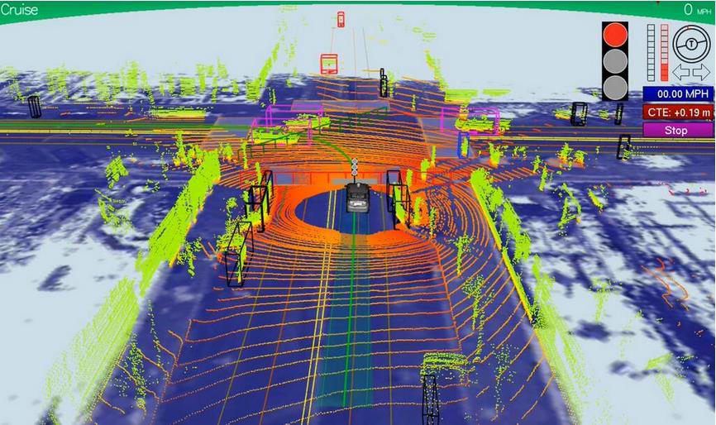
The algorithm to make a vehicle autonomous
The algorithm the autonomous cars need to follow usually works in this way: first, it creates an internal map of its environment and locates itself within it as precisely as possible, then it searches obstacles that would need to be avoided and, lastly, it plans the path it will need to follow. These processes are constantly done, many times per second.
First, to map the environment, as said, a laser rangefinder or a camera (or cameras) are used. The laser sensor creates a 3D model of its environment, which is accurate until 100m distance by sending laser beams and calculating the distance taking into account the time the light took to return. Here we can see an image of how the entourage of the car could look if using one of these sensors:
Representation of the information received by a LIDAR

Slide 11
The camera can detect colors and textures in images, but images are in 2D, so it’s not easy to know if an obstacle is small or it’s far, for example. However, if another camera is used, the car can detect depth by comparing the images of both cameras by stereo vision. This is how human vision works. On the other hand, they can’t see at night (car lights might not be enough) and computer vision may not detect obstacles like a LIDAR would. LIDARs are very expensive, but computer vision loads a lot the processor. There is a strong debate on which system is better suited for an autonomous car.
Since the GPS can have an error as big as some meters, the information of the position must be refined by fusing it with the information of the inertial sensor and the camera. This way, the knowledge of the positioning will be much more exact. To remove uncertainty from the GPS signal, a map is constantly updated internally to have already a previous map from the same location, with the current and predicted location of the obstacles near it. This map is updated with the vehicle’s movement.
Once the car has a map of its entourage, it tries to deduce where the obstacles will be in the future, so it can avoid them. This feature is very important since, without it, autonomous cars could be very dangerous and there would be no point on having them. Knowing where the other vehicles, people, etc… will be in the future allows the vehicle to take more intelligent decisions and react more conveniently in each situation, adapting its path planning to the conditions of its surroundings.
Once the map is updated and the obstacles are detected, the path planning comes. This part of the algorithm is focused on deciding the fastest and safest path between all of the possible

Slide 12
ones (based on its speed, direction, angular position, the obstacles and the rules of the road), eliminating the ones which are not feasible or safe enough.
Finally, when every decision has been taken (which, altogether may take 50ms or less), throttle, brake and steering signals are sent to the actuators by the onboard computer to achieve the desired actions and continue the way to its destination.
All these processes need to be repeated constantly until the destination has been reached.
Below these lines, a couple of images taken from Google’s webpage for their autonomous car can be seen, where all this process is explained and also some aspects about their concept of what an autonomous car should be like.

Slide 13
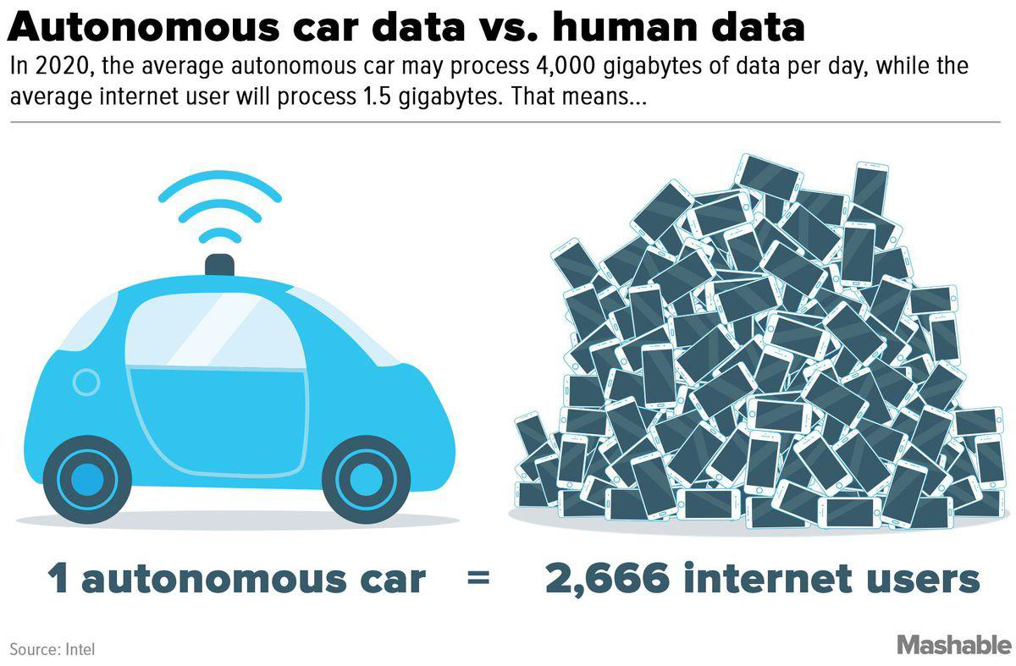
Human brain and autonomous vehicle

Slide 14
Risk/Issues with Autonomous Vehicle
Self-driving cars may not be able to navigate through heavy rain or snowstorm that could hide or distort the painted lines on roads and highways. This can make autonomous navigation systems, if not useless, at least, erratic.
Self-driving cars can be hacked just as any other computing device. Any skilled hacker could soon figure out a way to take control of a vehicle’s steering or acceleration. This can compromise the safety of the riders in a variety of ways.
There is also a possibility of terror attacks where the terrorist could gain control of an autonomous vehicle and use it as a weapon.
Constant exposure to EMF can play a part in health conditions including headaches, migraines, inner agitation, chronic exhaustion, sleeplessness, and susceptibility to infection. Autonomous cars are high-tech vehicles, which means it was designed to function through the use of different electronic devices – all emitting EMF radiation.

Slide 15
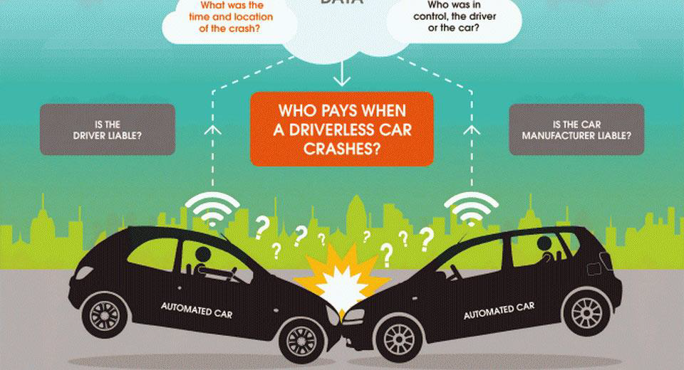
??

Slide 16
Future Planning or Projects
Going forward, more automakers will start to add highway-only SAE Level 3 capability to their cars. Slowly over time, the caveats that are present with this functionality in today’s cars will disappear. At some point in time, this Level 3 operation will transition to SAE Level 4—but only on highways.
It may be a decade or more before we see SAE Level 3 or 4 operation on normal streets due to liability reasons. Until the robotaxi-style SAE Level 4 operation that’s been successfully demonstrated by Waymo and others can be replicated universally on all roads, in all towns and cities, under any weather or traffic conditions, the risks are too great for carmakers to incorporate this functionality in their vehicles. (In 2018, an Uber self-driving car accidentally killed a pedestrian in Arizona—an incident that sent shock waves through the self-driving vehicle industry and led to a re-examination of many testing particles.)
However, it’s possible that in the medium-term future, some automakers may allow SAE Level 4 or 5 functionality to be “switched on” in certain geographic areas at certain hours of the day or in specific weather conditions (clear, sunny skies, for instance). While the “Vision Zero” goal of zero fatalities from traffic accidents may never be achieved in reality, it’s possible—even likely—that we will one day get very close to it.

Slide 17
CONCLUSION
It’s been a long journey research- and development-wise to get to the level we’re at currently regarding self-driving vehicle technology. Many millions of kilometers have been driven in test vehicles, and billions of kilometers have been run in simulations to get autonomous vehicle platforms to the state they’re in today. While some industry observers were predicting we’d all be driving SAE Level 5-capable autonomous cars by now, progress has been slower on several fronts than many researchers expected. Component costs, technology constraints, and simply the sheer number of potential scenarios that a vehicle can encounter when traveling on public roads have all been limiting factors that have impeded the rapid achievement of universal SAE Level 5 functionality. But if the recent past is anything to go by, it’s quite possible that by 2025, we’ll be well on our way to the long-envisioned dream of fully self-driving cars where the word “drive” will only apply to machinery, and the occupants in a vehicle will all be passengers.

Slide 18
THANK YOU

